Slide 1
Walking in Beauty and Harmony: Thinking Positively about the Future
Chapter 9

Slide 2

Walking in Beauty
Walking in beauty is to acknowledge your inner spirit and learning to connect with all of nature and the universe, remembering to never do harm to them.
When you feel capable in life and like someone who can contribute to your community and nation, you will find balance and harmony in your world.

Slide 3

Imagine Your Future

Slide 4

The Future?

Slide 5

Let’s Visualize Your Future

Slide 6
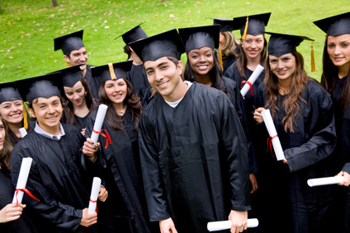
As a college student:
Visualize yourself in your cap and gown walking across the stage to receive your diploma.

Slide 7
Exercise:
Visualize Your Success
Draw a picture, make a list or write some sentences.
Share with the class

Slide 8

Powerful Tools for Success
Optimism
Hope
Future-Mindedness

Slide 9

Believe in Yourself
If we have positive beliefs about ourselves, we will feel confident and accomplish our life goals.

Slide 10
Beliefs:
Personal opinions about yourself, your life and the world around you

Slide 11
For Example
If I believe I am not good in math, I may not do the assignment or may even avoid taking math.
If I believe I can be good in math, I can take the steps needed to be successful.

Slide 12
The Self-Fulfilling Prophecy
Our expectations influence our behaviors.
The behavior causes our expectations to come true.

Slide 13
Robert Rosenthal
Did experiments on the “self-fulfilling prophecy.”
Positive expectations led to positive outcomes.

Slide 14

Positive Self-Talk
The thoughts or silent inner voice in our heads

Slide 15

Negative Thoughts
Can be toxic to the body
Can cause biochemical changes that lead to depression

Slide 16

Positive Thoughts
Build good self-esteem
Help us to become confident in our abilities
Help us to achieve our life goals

Slide 17
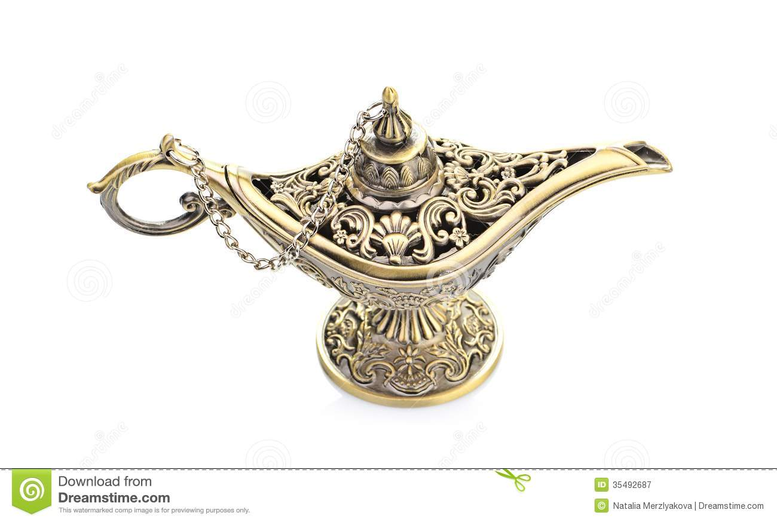
On a sunny beautiful San Diego day, you are walking on the beach and suddenly to stub you toe on something in the sand.
Affirmations
You look down and see something is stuck in the sand. You bend over and pick it up. You brush off the sand off, It’s a lamp!

Slide 18
Exercise
The lamp tells you it will grant you 3 wishes with the following
conditions.
1. You cannot wish for money
2. You cannot wish for more wishes
3. It must be for you
4. It must me realistic
What three wishes would you wish for?

Slide 19
Change the wishes to affirmations
Example:
The wish: I wish for good health.
The affirmation: I enjoy having good health.
Share your affirmations statements with the class

Slide 20

About Your Life and Your Future

Slide 21
Guidelines for Increasing Positive Thoughts
Monitor your thoughts. Are they positive or negative?
When you notice a negative thought, imagine rewinding the message and recording a new positive message.

Slide 22
Guidelines for Increasing Positive Thoughts
Start the positive message with “I” and use the present tense.
Make your affirmation stronger by visualizing what you want to achieve.
Repeat positive thoughts to yourself until they become a habit.

Slide 23
Athletes Use Visualization
A good way to practice
Helps you to pre-experience events in your mind
For example, pole-vaulters imagine the perfect jump before they make it

Slide 24
Visualization
We create all things twice.
  Make a mental picture.
  Create the physical reality by taking action.

Slide 25
For example:
In building a house we
  Create a blueprint or plan
  Then we build the house

Slide 26
Hope for the Best
Believing that you can be successful helps you to be successful.
Hopeful students are more successful.

Slide 27

Seven Habits of Highly Successful People

Slide 28
Be Proactive
Accept responsibility for your life.

Slide 29
Begin with the end in mind.
Know what is important.
What do you want to accomplish in your life?

Slide 30
Put first things first.
Set priorities.

Slide 31
Think win-win.
Seek solutions that benefit everyone.
Focus on cooperation rather than competition.

Slide 32
First seek to understand. Then be understood.
Listening is the first step in effective communication.

Slide 33
Synergize.
The whole is greater than the sum of its parts.
Working together as a team, you can accomplish more than each member can accomplish separately.

Slide 34
Sharpen the saw.
Invest time in yourself to stay healthy:
  Physically
  Mentally
  Spiritually
  Socially

Slide 35
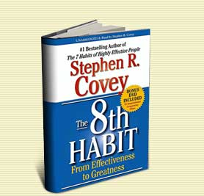
Find your voice and inspire others to find theirs.
Believe that you can make a difference in the world and inspire others to do the same.

Slide 36
Understanding Life Stages
Understand the present.
Take a glimpse into the future.

Slide 37
Finding happiness in your life.

Slide 38
Steps to Happiness
Express gratitude.
Cultivate optimism.
Avoid over thinking and social comparison.
Practice acts of kindness.
Increase flow activities.

Slide 39
Steps to Happiness
Savor life’s joys.
Commit to accomplishing your goals.
Take care of your body.

Slide 40
Secrets to Happiness
Martin Seligman
Achieve happiness by identifying, cultivating, and using your personal strengths in work, love, play, and parenting.

Slide 41
Happiness = S + C + V
S is your set range (50% of happiness is determined by heredity)
C is your circumstance (8-15 % of happiness)
V is what is under your voluntary control (40%)

Slide 42
What are some examples of factors under your voluntary control?

Slide 43
More Secrets to Happiness

Slide 44
Secrets to Happiness
Happiness can’t be bought.
Happiness is more internal than external.
Happiness is not determined by age, race, gender or income.
Happiness won’t arrive in the Publisher’s Clearinghouse envelope.

Slide 45
Secrets to Happiness
Happiness depends less on things than on our attitude toward the things we have.

Slide 46
Make a decision to choose happiness.

Slide 47


Find small things that make you happy and sprinkle your life with them.

Slide 48
Laugh more. Laughter produces a relaxation response.

Slide 49

A good joke beats a pill for a lot of ailments.

Slide 50
Learn to think like an optimist. Assume you will succeed.

Slide 51
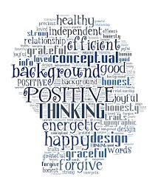

Replace negative thoughts with positive ones.

Slide 52
Do things that use your skills.

Slide 53
Fill your life with things you like to do. Remember the 20 things you like to do?

Slide 54
Get enough rest.

Slide 55
Exercise to feel good and to cope with anxiety.

Slide 56

There are no substitutes for fresh air, sunshine and exercise.

Slide 57
Reduce stress.

Slide 58
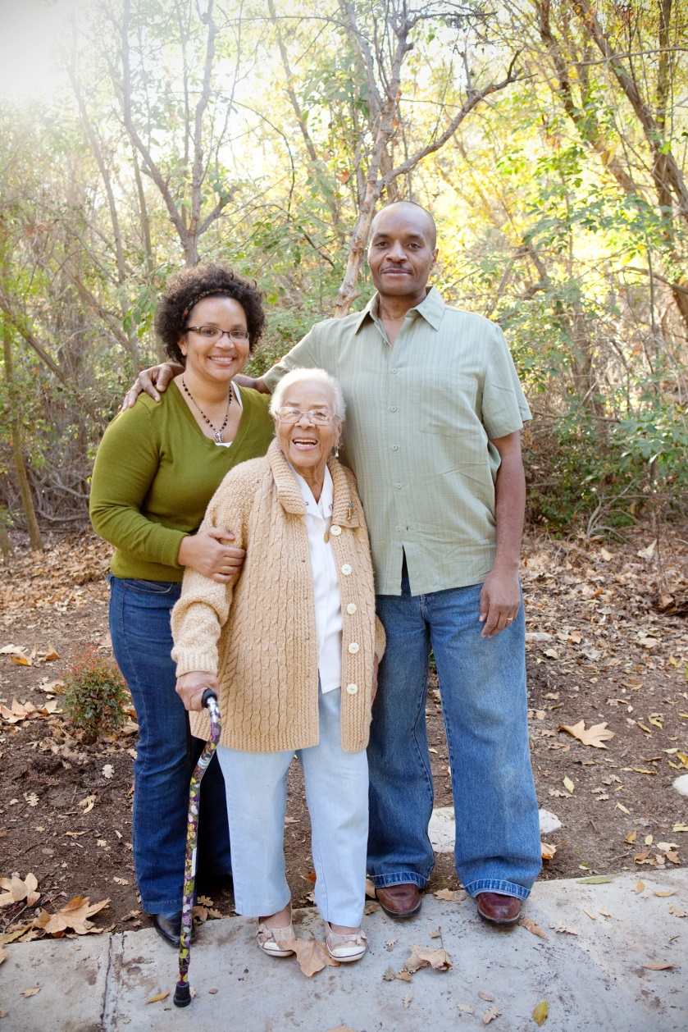

Close relationships are important.

Slide 59
If you don’t do anything else in life, love someone and let someone love you.

Slide 60

Keep things in perspective. Will it matter 10 years from now?

Slide 61
Exercise:
Happiness Is . . . .
Share Your Ideas

Slide 62
Making Positive Changes in your Life
Precontemplation
Contemplation
Preparation
Action
Maintenance
Termination

Slide 63
Keys to Success:
You Are What You Think

Slide 64
What we believe is true, comes true.
What we believe is possible, becomes possible.
--Henry Ford

Slide 65
Watch your thoughts; they become words.
Watch your words; they become actions.
Watch your actions; they become habits.
Watch your habits; they become character.
Watch your character; it becomes your destiny.
Frank Outlaw

Slide 66

Grand Essentials of Life

Slide 67

Grand Essentials of Life
Something to do (that you like)

Slide 68
Grand Essentials of Life
Something to do (that you like)
Someone to love

Slide 69

Grand Essentials of Life
Something to do (that you like)
Someone to love
Something to hope for

Slide 70

Use the tools in this book to create your success.

Slide 71
This is not the end of the course but a new beginning.

Slide 72
Celebrate!
CONGRATULATIONS
Future
Graduates

Slide 73
Review the Keys to Success in this book. What is your favorite one and why?

Slide 74

Stories from the Elders
Coyote Creates the Earth
What did you learn from this story?

Slide 75

Measure Your Success
Complete the exercise.
Pick up the one you did the first day of class.
Compare your results. Is your score higher?
Staple the two exercises together and hand them in.

